Slide 1
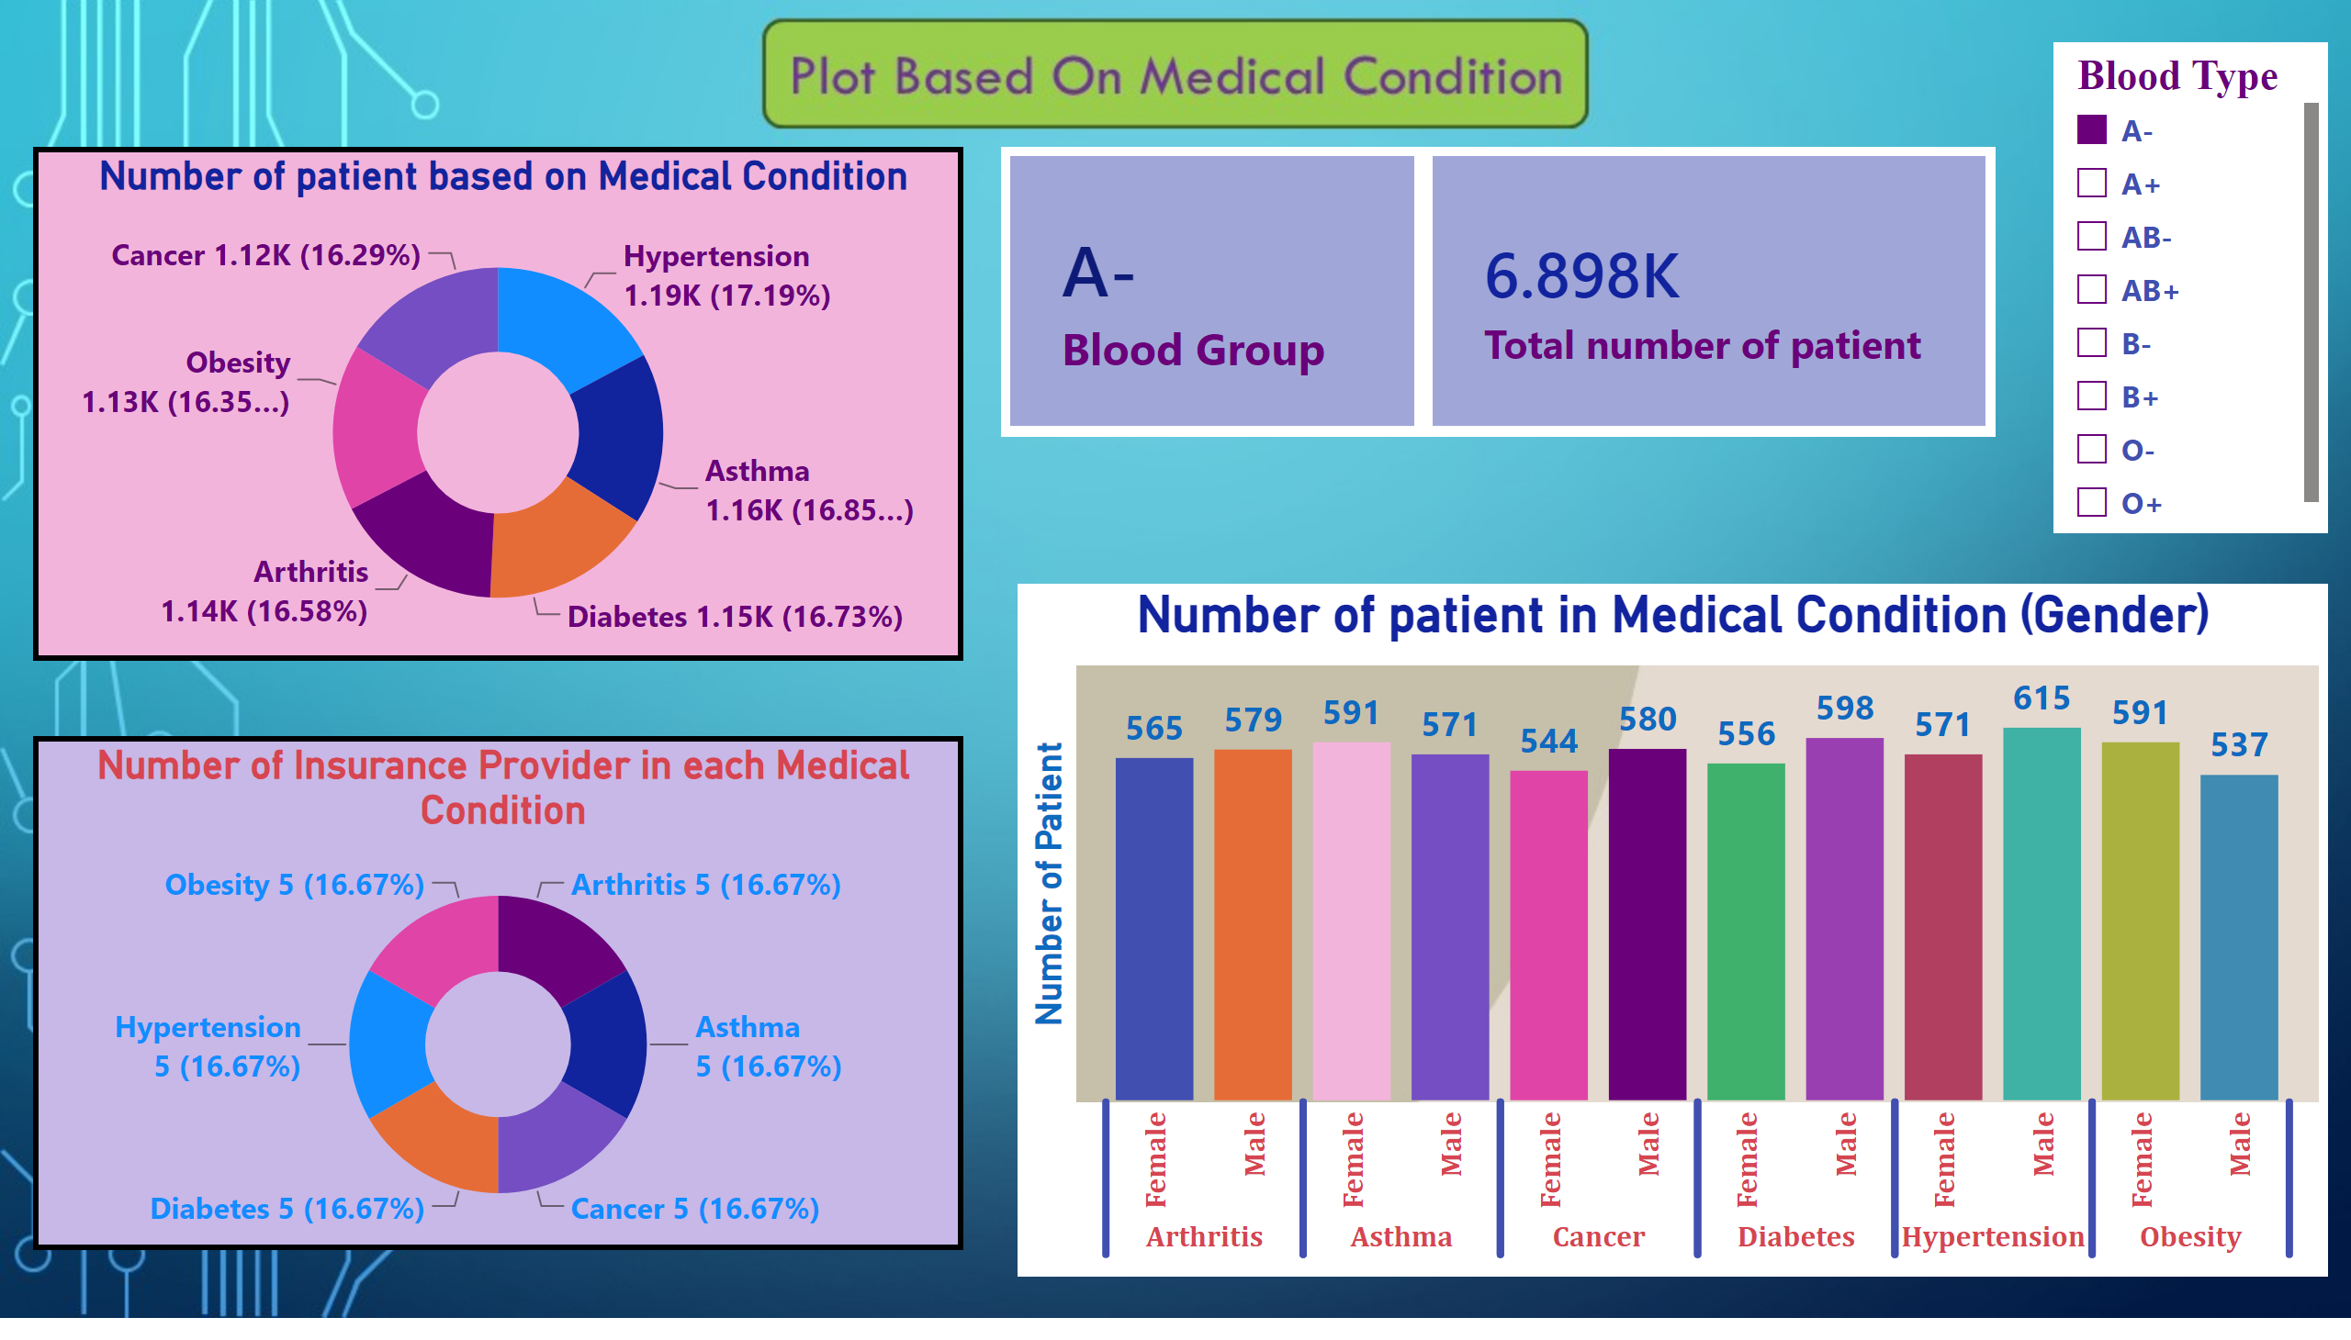
Dashboard 1
Notes:
Number of patient based on Medical Condition
No alt text provided
cardVisual
No alt text provided
cardVisual
No alt text provided
slicer
No alt text provided
Number of patient in Medical Condition (Gender)
No alt text provided
Number of Insurance Provider in each Medical Condition
No alt text provided

Slide 2
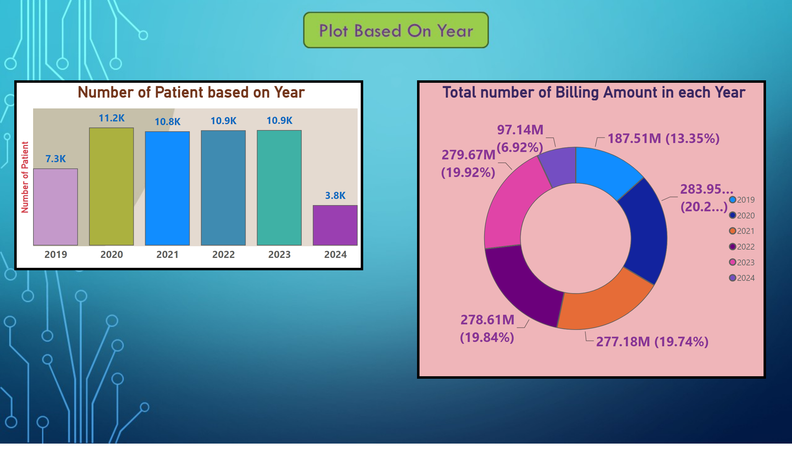
Dashboard 2
Notes:
Number of Patient based on Year
No alt text provided
Total number of Billing Amount in each Year
No alt text provided

Slide 3
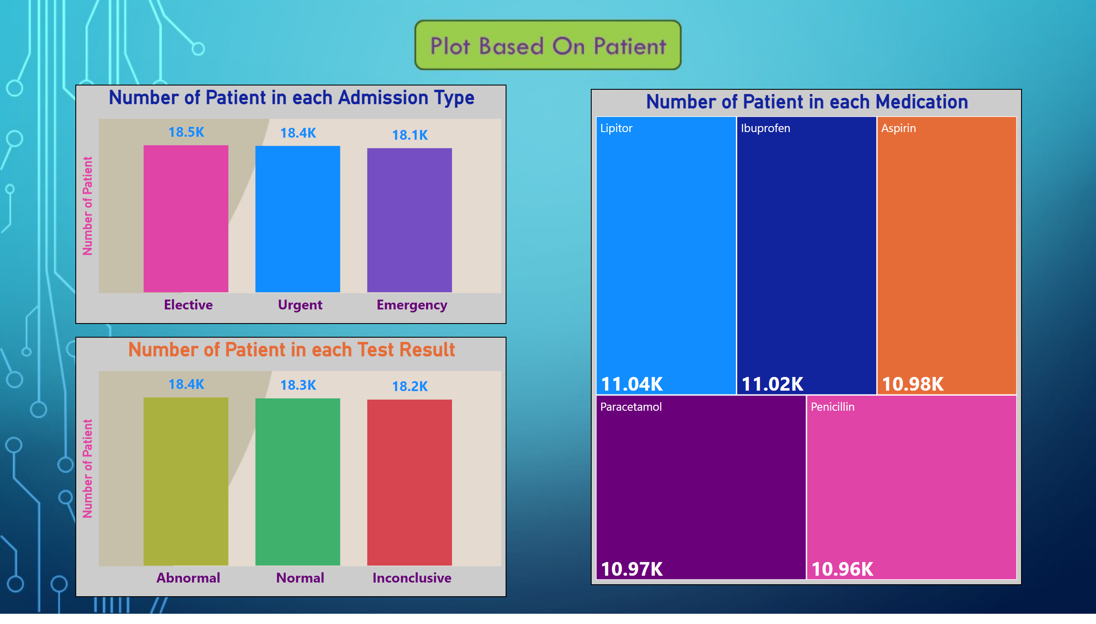
Dashboard 3
Notes:
Number of Patient in each Admission Type
No alt text provided
Number of Patient in each Test Result
No alt text provided
Number of Patient in each Medication
No alt text provided

